Slide 1

Domain: MATLAB
Technology: COMMUNICATION
DIGITAL SIGNAL PROCESSING TECHNIQUES FOR REMOVING NOISE FROM ECG SIGNAL

Slide 2
Index
Abstract
Introduction
Literature review
Existing Method
Disadvantages
Proposed method
Advantages
Applications
Hardware and Software Requirements
Results
Conclusion
References

Slide 3
Abstract
In the great majority of systems today, signal processing is used for ECG analysis and interpretation. An ECG measures the electrical signal from the heart and can reveal important details about heart functionality in addition to detecting various heart diseases. But, ECG signals are sensitive to disturbances during this process. Its amplitude and duration can be distorted by different disturbances, which might occasionally result in a wrong diagnosis. So noise reduction serves as yet another crucial goal of ECG signal processing. MATLAB software can be used to eliminate Baseline Wander, Powerline Interface, and Electrode Motion Artifact noises in this project. Baseline Wander is a 0.5–0.6 Hz low-frequency noise. In order to improve peak detection performance, this study introduces a new peak detection method that can suppress noise and adjust to variations in ECG signal morphology. The suggested approach is founded on segmentation, time and amplitude thresholds, statistical false peak elimination, and median and moving average (MA) filtering (SFPE). To eliminate undesired noise and interference, the filters are first applied during preprocessing. A time axis (x-axis) threshold and an amplitude (y-axis) threshold are used to examine each segment of the data after it has been separated into smaller segments. Next, the erroneous peaks caused by any remaining noise are removed using the average peak-to-peak interval. Any peak that is spotted twice is removed, and a post-processing stage is introduced to look for missed low-amplitude peaks. The suggested strategy outperforms a number of cutting-edge approaches in the field when tested on the MIT-BIH arrhythmia and Fantasia databases.

Slide 4
Introduction:
Heart is the one organ that is responsible for almost all of the processes in the Human Body. Major work of a Human Heart is pumping of Blood, Blood is the one thing that is responsible for every process in the entire Human Body. Blood contains Hemoglobin which is oxygen carrying protein, oxygen is the single most important thing that is required by the Human Body. So, the oxygen is supplied to various parts of the body through Blood. Without the Blood many organs that may be from the Brain to Hair everything will not work. We can’t put it in words, of “How much our Body depended on the Heart”, so, a healthy and hygienic lifestyle to be followed for a better working of the Heart. Health and many diseases are depended on functioning of the Heart, so, it became very essential task to record the functioning of Heart, for that, scientists came up with the idea of Electro-Cardiogram (ECG) Signals which records the activity of the Human Heart.
Electro-Cardiogram or ECG records the electrical activity of the Human Heart using the electrical signals produced by the Heart. Even though the ECG produces the electrical activity of the Heart, the resultant signal extraction become a hard and complex task where we are losing the vital information related to the Heart. So, there exists a number of techniques and methods for extracting the important information from the ECG signal. A typical ECG signal contains PQRST waves of which QRS are the most significant waves, so, extracting at least these three peaks are is an important task.

Slide 5
Literature review:
S. NO | Journal Type with year | Authors | Title | Outcomes
1 | Comput. Biol. Med., vol. 87, pp. 187–199 | T. Sharma and K. K. Sharma | QRS complex detection in ECG signals using locally adaptive weighted total variation denoising | Studied about the QRS detection using locally adaptive weighted denoising
2 | IEEE Eng. Med. Biol. Mag., vol. 21, no. 1, pp. 42–57, Aug. 2002R | B.-U. Kohler, C. Hennig, and R. Orglmeister | The principles of software QRS detection | Studied about the principles of software QRS detection
3 | J. Healthc. Eng. 2018 | K X. Lu, M. Pan, Y. Yu | QRS detection based on improved adaptive threshold | Studied about QRS detection based on improved adaptive threshold
4 | John Wiley & sons, 2015 | R. M. Rangayyan | Biomedical Signal Analysis | Studied about the Biomedical Signal Analysis
5 | IEEE Trans. Biomed. Eng. (3) (1985) 230-236 | J. Pan, W.J. Tompkins | A real-time QRS detection algorithm | Studied about a real-time QRS detection algorithm

Slide 6
Existing methods:
Similar to most other QRS detection techniques, the proposed method consists of two stages: a preprocessing stage and a peak detection stage, as shown in the block diagram in Fig. 1. The preprocessing is carried out block-by-block, the size of each block being N, to have a local estimate of noise in the denoising operation. The preprocessing is carried out in a series of steps that aim at suppressing the noise peaks and the P- and T waves, and accentuating the QRS complexes. Since the preprocessing is done block-by-block, edge effects can occur after filtering, because of abrupt truncation, and hence, false peaks can be detected at the block boundaries. To avoid this issue, symmetric padding is done on the blocks on both sides before filtering, by using reflecting boundary conditions.

Slide 7
Disadvantages in Existing methods:
The method is not very good extracting peaks.
The method doesn’t consider of very low peaks.
The method is not effective at detection of q and s peaks.

Slide 8
Proposed method:
The noise filtered ECG signal will be sent to the Peak detection stage where the peaks are detected using Amplitude and Time Thresholds. The thresholds for estimating the QRS peaks. The thresholds are done based on the statistical analysis of the ECG signal. The thresholds are the values that result in the typical QRS peaks or waves. The particular Q peak or R peak or S peak will have a regular time instants or lengths or heights. These can be used to threshold to extract the near exact Q or R or S peaks. The peak detection will be more better whenever there is better thresholds. For that we have to remove the noise at a greater value. The R peaks are the most and easily detectable among all of the ECG peaks. The typical tallest peak or that which peak that has highest amplitude in an ECG signal is always an R peak. So, the R peaks are easily be extracted and can be used for reference in estimating the other peaks. Like the difference between the two R peaks and the threshold difference between the QR peaks as well as RS peaks. So, the threshold will result in better way, if the R peaks are detected perfectly.

Slide 9
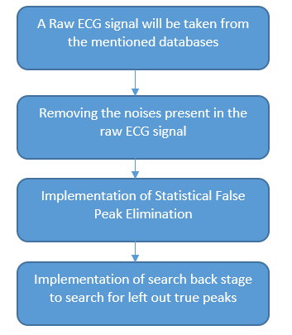
Flow of the proposed method

Slide 10
Advantages of Proposed method:
The SFPE algorithm is quite good at thresholding.
SFPE algorithm is effective in the case of low amplitude peaks.
SFPE algorithm is also effective in the case of removing noise that degrades the signal.

Slide 11
Applications:
Applied in DSP applications
ECG Peak Detection
Bio-Medical Signal Processing
Image Processing

Slide 12
Hardware and Software Requirements:
Hardware & Software Requirements:
Software: Matlab R2018a.
Hardware:
Operating Systems:
• Windows 10
• Windows 7 Service Pack 1
• Windows Server 2019
• Windows Server 2016
Processors:
Minimum: Any Intel or AMD x86-64 processor
Recommended: Any Intel or AMD x86-64 processor with four logical cores and AVX2 instruction set support
Disk:
Minimum: 2.9 GB of HDD space for MATLAB only, 5-8 GB for a typical installation
Recommended: An SSD is recommended a full installation of all Math Works products may take up to 29 GB of disk space
RAM:
Minimum: 4 GB
Recommended: 8 GB

Slide 13
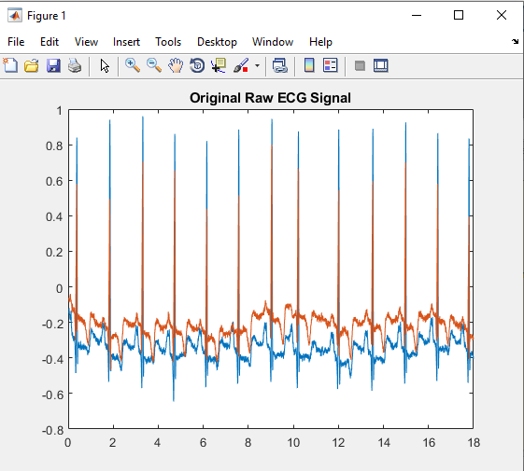
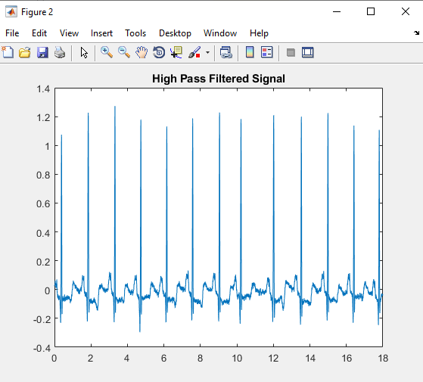
Results

Slide 14
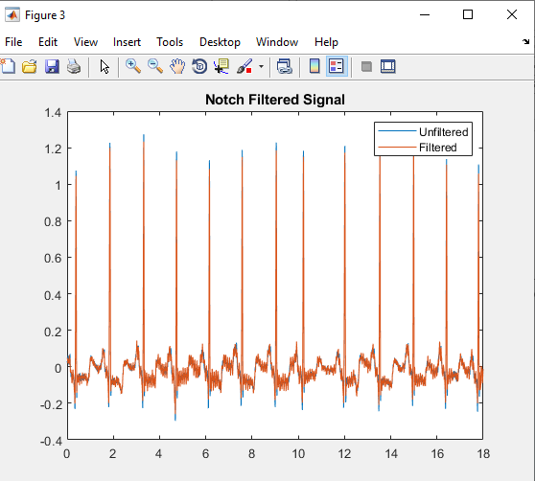
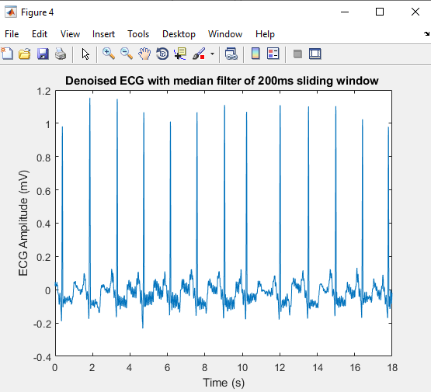

Slide 15
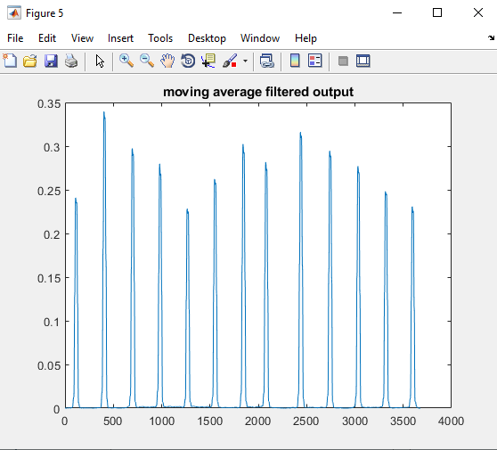
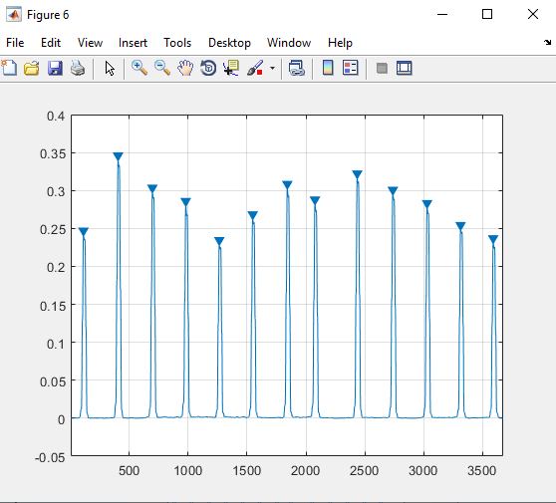

Slide 16
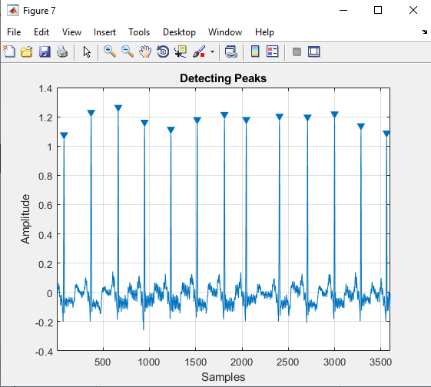

Slide 17
Conclusion
We can finally conclude that, the QRS peaks are extracted and detected using Statistical False Peak Elimination (SFPE) which employs a median filtering along with a moving average filter to filter out noise and interference terms from the original ECG signal and left out true peaks are sent to Selective. The SFPE uses the statistical analysis to threshold the QRS peaks that may be left out during the previous stage. The SFPE detects the QRS true peaks and later, a search back stage is employed which again detects for the any left out true peaks which makes the detection even more robust. The present technique of Statistical False Peak Elimination (SFPE) is employed along with a search back stage gives better detection results compared with the previous techniques.

Slide 18
References:
[1] T. Sharma and K. K. Sharma, ‘‘QRS complex detection in ECG signals using locally adaptive weighted total variation denoising,’’ Comput. Biol. Med., vol. 87, pp. 187–199, Aug. 2017.
[2] B.-U. Kohler, C. Hennig, and R. Orglmeister, ‘‘The principles of software QRS detection,’’ IEEE Eng. Med. Biol. Mag., vol. 21, no. 1, pp. 42–57, Aug. 2002R. Nicole, “Title of paper with only first word capitalized,” J. Name Stand. Abbrev., in press.
[3] K X. Lu, M. Pan, Y. Yu, QRS detection based on improved adaptive threshold, J. Healthc. Eng. 2018 (2018).
[4] R. M. Rangayyan, Biomedical Signal Analysis, 33, John Wiley & sons, 2015.
[5] J. Pan, W.J. Tompkins, A real-time QRS detection algorithm, IEEE Trans. Biomed. Eng. (3) (1985) 230-236.
[6] J.D. Drake, J.P. Callaghan, Elimination of electrocardiogram contamination from electromyogram signals: an evaluation of currently used removal techniques, J. Electromyogr. Kinesiol. 16 (2) (2006) 175-187.

